Slide 1

Do smoking, sex, age and BMI affect health insurance cost and by how much?
Warren wang
Divya seth
Gulshan laskar
Chandanarchutha Namburu

Slide 2
Project overview:
Purpose: To examine and quantify the effects of smoking, age, sex and BMI(Body Mass Index) on the amount of health insurance charges.
Population: 18-64 years old male and female beneficiaries.
Variables of interest: smoking status, age, sex, BMI, and health insurance charge amount.
Parameters of interest: mean, standard deviation.
Statistical inferences performed: Hypothesis testing, bootstrap confidence interval.

Slide 3
Data Collection:
We obtained secondary data from Kaggle.
Dataset: Medical cost personal dataset collected from US Census Bureau.
Dataset link: https://www.kaggle.com/datasets/mirichoi0218/insurance/data
Data on individual demographics , health/practice information and cost of personal insurance.

Slide 4
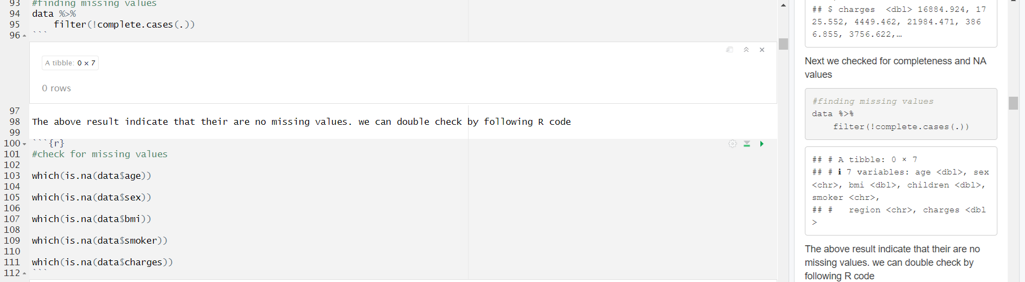
Data Cleaning:
We checked it for missing values, completeness and structure
Tidyverse and Dplyr
Used inbuilt functions like glimpse and checked the summary to find any NA values
Data was primarily clean

Slide 5
Summary Statistics:
The total data set contains 1338 observation and 7 variables ( Numerical and categorical).
The categorical variables : Sex, Smoking Status and Region.
The Numerical variables : Age, BMI and Charges.
The population comprises of 662 females and 676 males in the age range of 18- 64.
Mean age for the population is 39.21.
Mean BMI is 30.66.
Mean insurance cost is 13270 dollars.

Slide 6
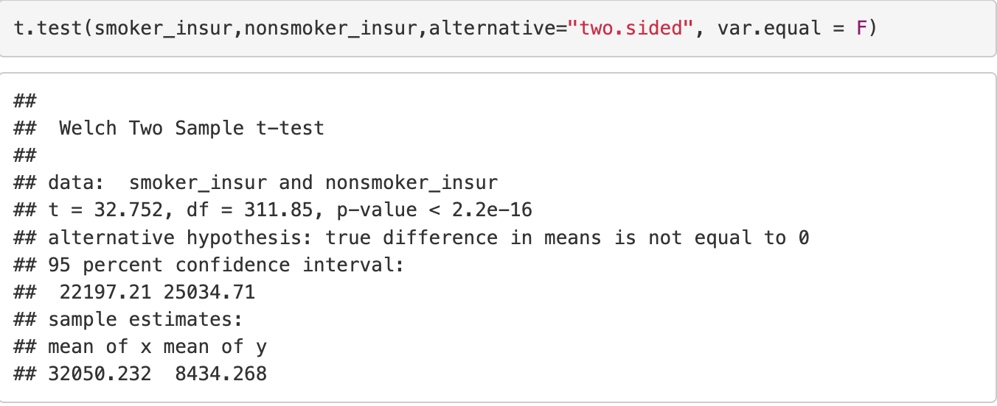
Hypothesis Testing 1: Smoking vs Charges
Null: The average value of smoker and nonsmoker insurance charge is the same.
Alternative: The average value of smoker insurance charge isn't the same as nonsmokers.
The p-value is way less than 0.05. Therefore, we strongly reject the null hypothesis and conclude that smokers insurance amount isn't the same as nonsmokers.

Slide 7
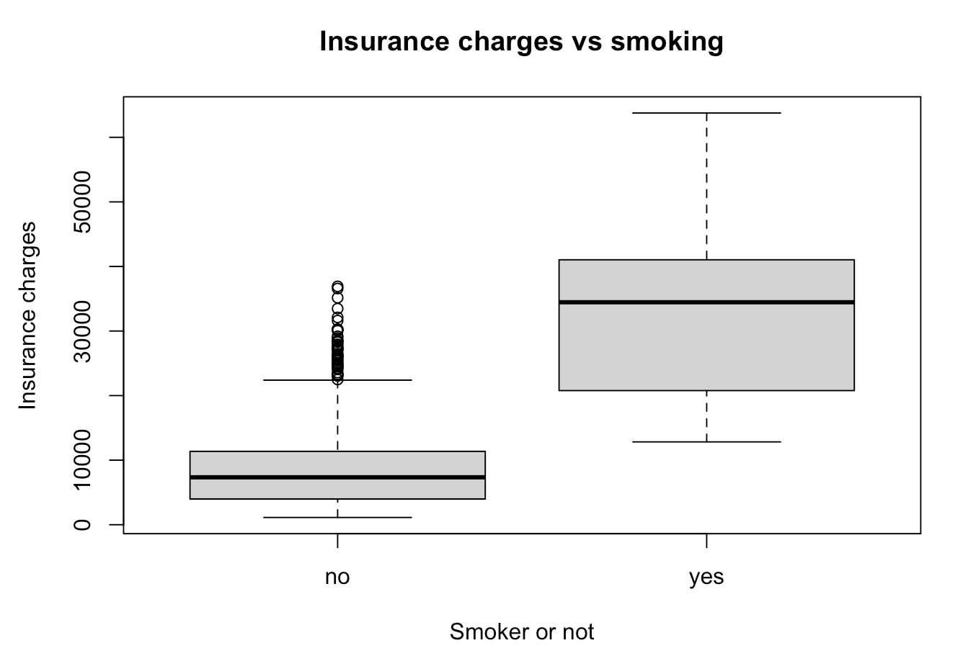
Boxplot confirms it!

Slide 8
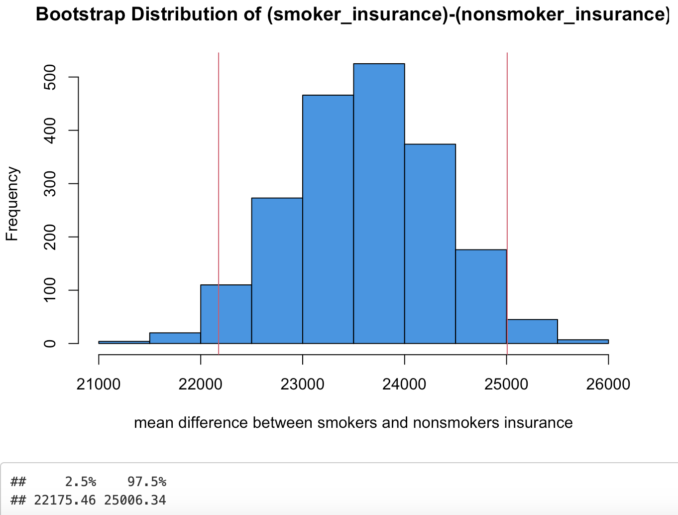
So... How much more do smokers pay?
As we can see, smokers can pay as much as $25006 dollars more per year for health insurance! Therefore, be a good person and don't smoke :)

Slide 9
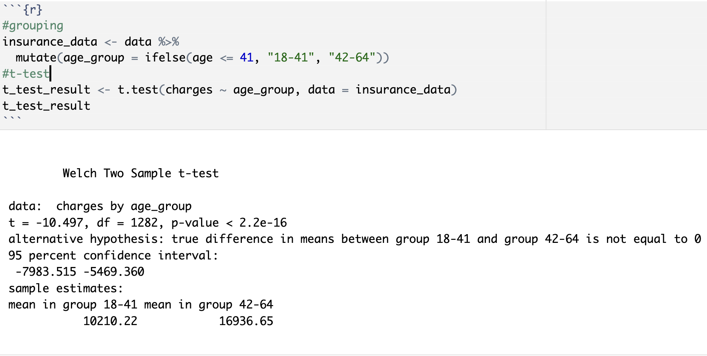
Hypothesis Testing 2: Age Vs Charges:
Null Hypothesis (H0) : There is no difference in the average medical charges between the two age groups.
Alternate Hypothesis (Ha) : There is a significant difference in the average medical charges between the two age groups.
t – Test :
G1 : age (18-41)
G2 : age (42-64)
As (p-value is < 0.5), So, we reject the null hypothesis.
G2 has higher average medical charges than G1 which is by $5,469.36 to $7,983.52.

Slide 10
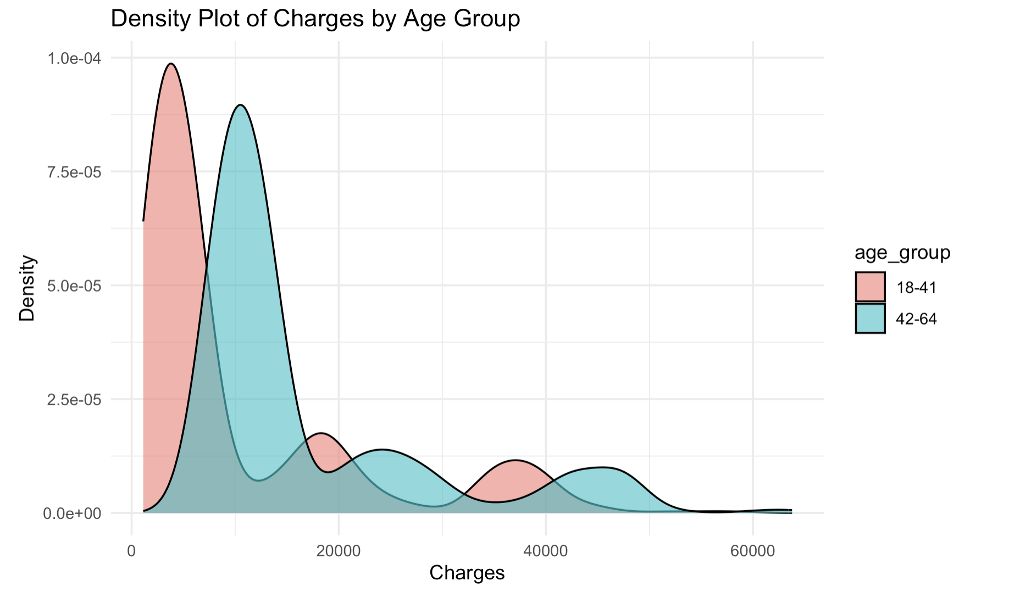
Density Plot :
G2 (42-64) age group have a broader spread of medical charges.
Higher density for the G1(18-41) .

Slide 11
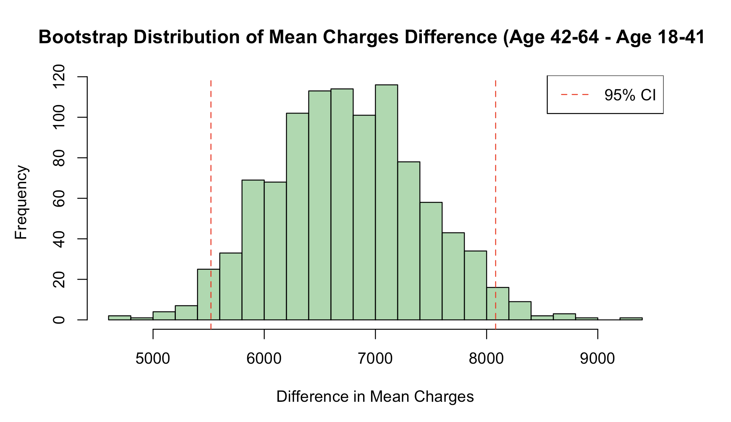
Bootstrap Confidence Interval :
The 95% confidence interval for the difference in mean charges is ($5507, $8055.05).
Who are paying more charges?
Individuals in the age group 42-64 tend to have average charges that are between $5,507 and
$8,055 higher than those in the age group 18-41.

Slide 12
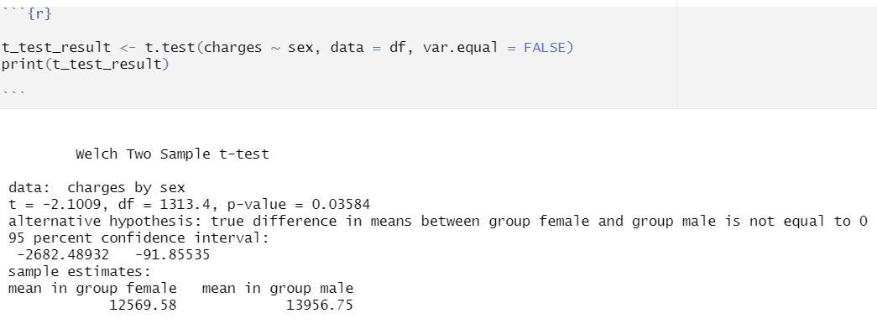
Hypothesis Testing 3: Sex vs Charges:
Null: There is no significant difference in the mean insurance charges between males and females.
Alternative: There is a significant difference in the mean insurance charges between males and females.
Since the P-value(0.03584) is less than 0.05, we reject the null hypothesis.

Slide 13
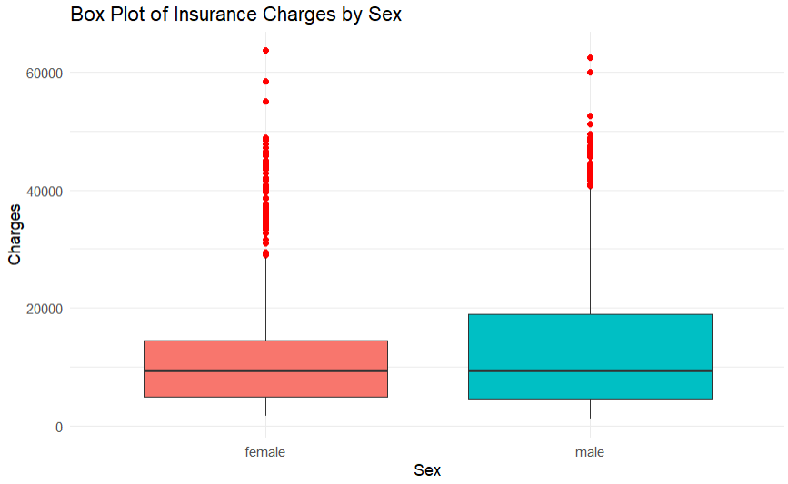
The medians for both males and females are quite close, but males tend to have a wider range of charges.
The spread and range of the charges for males are larger than for females, indicating that males generally pay more insurance charges.

Slide 14
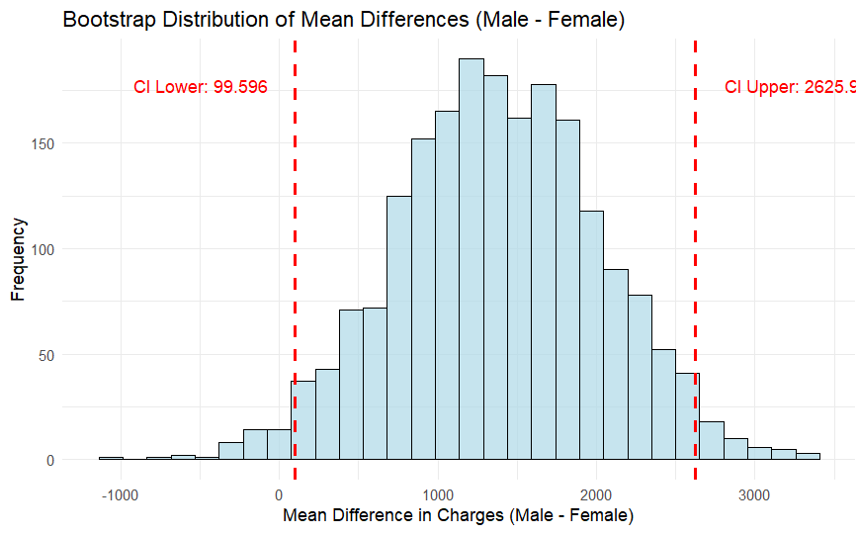
Bootstrap confidence interval:
Lower bound = 99.59
Upper bound = 2625.96
The entire interval is above zero, indicating a significant difference between the mean charges of males and females, which supports our hypothesis testing.
On average, males pay between 99.59 and 2625.96 more insurance charges than females.(in dollars)

Slide 15
Hypothesis Testing 4 : BMI vs Insurance Charges
Body mass index (BMI) is a health indicator of nutritional status and defines the health risk situation
Null hypothesis : The BMI has no effect on the personal insurance cost
Alternate Hypothesis : The BMI effects personal insurance cost
The normal range for BMI for a healthy adult is between 18.5 to 24.9. (WHO classification)
For the ease of analysis , we classified all others as : at risk
Thus, We divided the entire data into 2 subsets.
1. BMI normal: In the range ( 18.5-24.9)
2. BMI at risk: above and below the normal range.

Slide 16
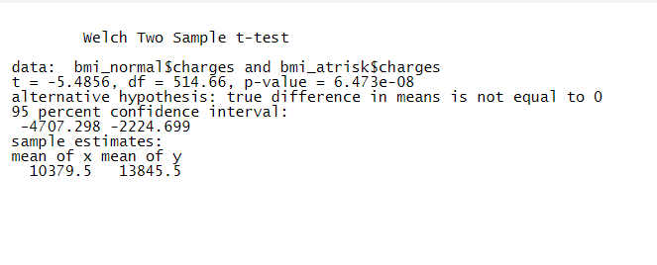
2-sample t –test : Insurance cost BMI Normal & BMI: At risk
Calculate the difference in mean values in insurance cost between the two subsets.
Mean : 13079.5,(normal), 13845.5 (at risk)
T- statistics : -5.48546
Smaller p value than the .05 significance level , the difference in means of insurance cost is significant
confidence interval : -4707.298 and -2224.669. This range does not include 0 : there is a significant difference between the means.

Slide 17
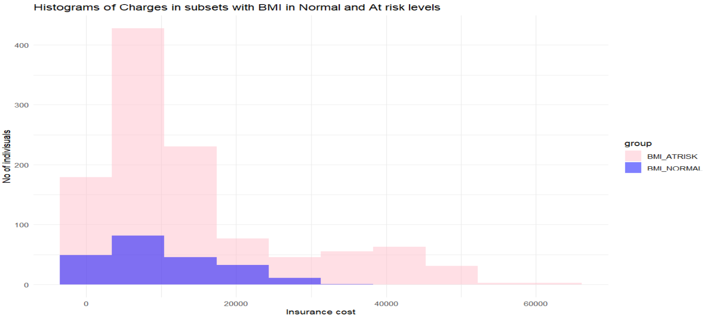
Significant difference between the insurance charges in both subsets ( BMI Normal and BMI At Risk)
Thus, we can predict with 95 % confidence that the difference in insurance cost in the two subsets is significant and as the p value is less than .05 , we reject the null hypothesis and accept that alternate hypothesis. The cost of insurance is different for both groups.

Slide 18
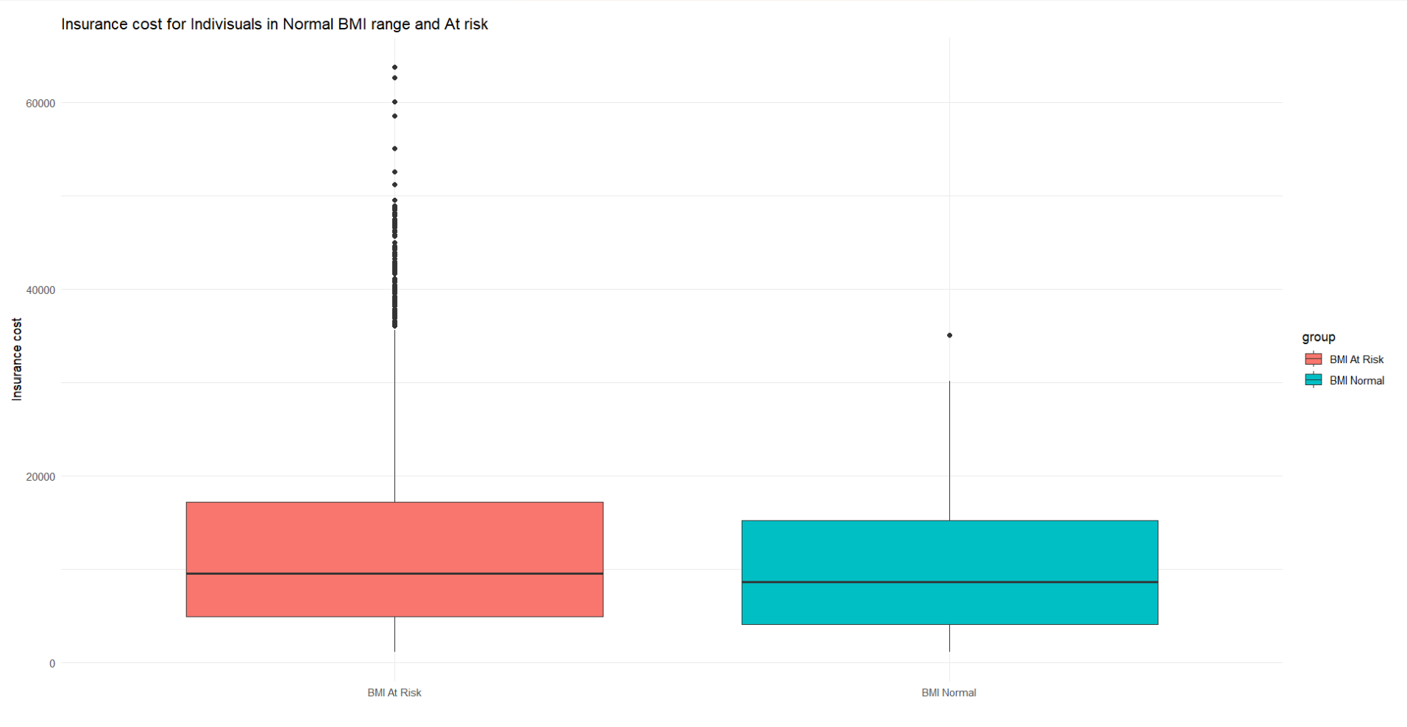
Boxplot 2: Insurance cost for individual in Normal and At-risk range.

Slide 19
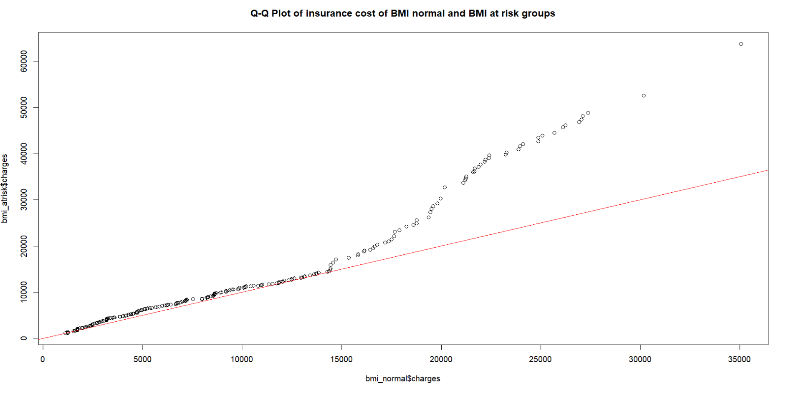
When data is non-normal or has outliers, creating a bootstrap distribution is useful.

Slide 20
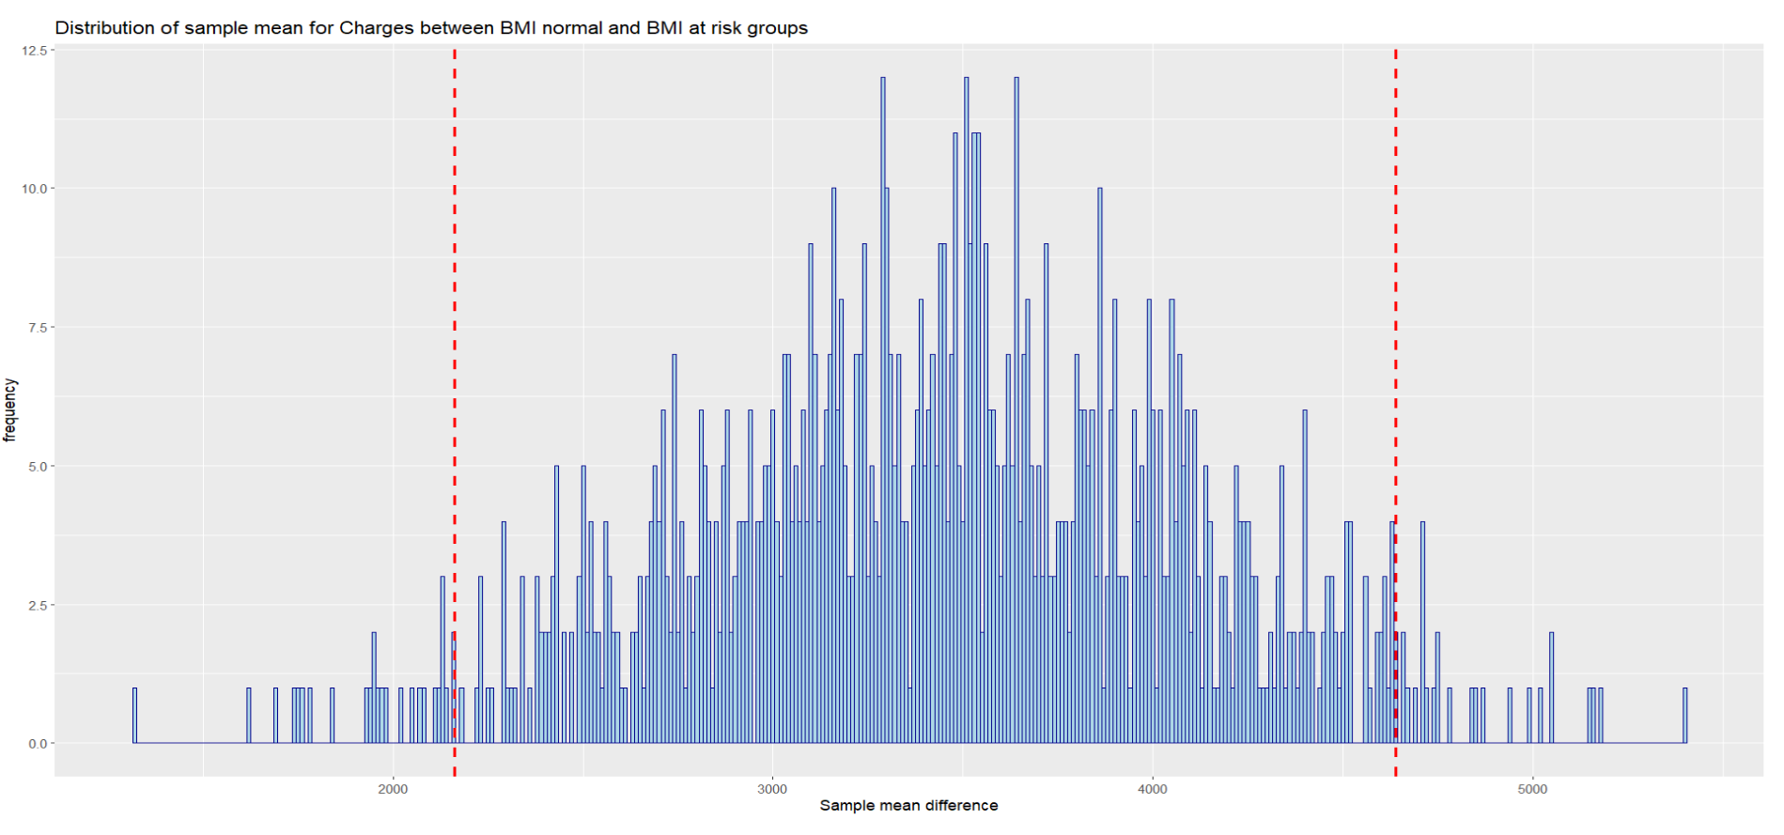
Bootstrap confidence interval : 2161.963 - 4639.211 The confidence interval is positive , which indicate that the insurance cost lies in the confidence interval.
Thus, we can say that the individual with a BMI in at risk range might have to pay approximately 2200 - 4600 $ more than the person with BMI in the normal range

Slide 21
Results:
Smoking, age, sex and BMI all have effects on personal insurance.
Smokers can pay up to $25006 dollars more per year for health insurance than nonsmokers.
Older age group can pay up to $7977 more than younger age group.
Males can pay up to $2625.96 more than females.
People with at-risk BMI would pay up to $4639 more than the ones with normal BMI.

Slide 22
Thank you!
Questions?

Slide 23
References:
Sun Life Staff. (2023, January 30). Life Insurance for Smokers. Life Insurance For Smokers | Sun Life Canada. https://www.sunlife.ca/en/insurance/life/how-does-smoking-affect-your-life-insurance/
Life Insurance Insights. (2024, July 10). Impact of height and weight on life insurance in Canada: How is height and weight used in life insurance? What is BMI and why is it important in life insurance? [Blog post]. Life Insurance Insights. https://www.lifeinsuranceinsights.com/impact-of-height-and-weight
World Health Organization. (2021, May 6). A healthy lifestyle - WHO recommendations. World Health Organization. https://www.who.int/europe/news-room/fact-sheets/item/a-healthy-lifestyle---who-recommendations
Mylona, E. K., Benitez, G., Shehadeh, F., Fleury, E., Mylonakis, S. C., Kalligeros, M., & Mylonakis, E. (2020). The association of obesity with health insurance coverage and demographic characteristics: A statewide cross-sectional study. *Medicine, 99*(27), e21016. https://doi.org/10.1097/MD.00000000000210164.
Sun Life. (n.d.). Life insurance adult build tables. Sun Life. Retrieved October 14, 2024, from https://suncentral.sunlife.ca/en/client-service/new-business-and-underwriting/applying-and-underwriting/life-insurance-underwriting/life-insurance-adult-build-tables/

